Slide 1
WELCOME TO DAY-3

Slide 2
Any Doubts? Yesterday Session

Slide 3
Table of Contents
lISTS
IMAGE,AUDIO,VIDEO
What is a list
Inserting img, video, audio files
FORMS
TABLES
How to create a forms like contact form
What are these tables

Slide 4
LISTS
<li> Used to create lists </li>
The following types of Lists is used in HTML
Ordered List or Numbered List <ol>
Unordered List or Bulleted List <ul>
Defination List <dl>

Slide 5
An ordered list. This will use different schemes of numbers to list our items.
<ol> tag contains inividual list items represented by the <li>tag.
Both <li> and <ol>, are container tags.
Type attribute to define the numbering type
<ol>
<li>Amber Fort and Palace</li>
<li>Nahargarh Fort</li>
<li>Hawa Mahal</li>
</ol>
Ordered
Lists

Slide 6
The Type Attribute of <ol> tag
type="1" The list items will be numbered with numbers (default)
type="A" The list items will be numbered with uppercase letters
type="a" The list items will be numbered with lowercase letters
type="I" The list items will be numbered with uppercase roman numbers
type="i" The list items will be numbered with lowercase roman numbers

Slide 7
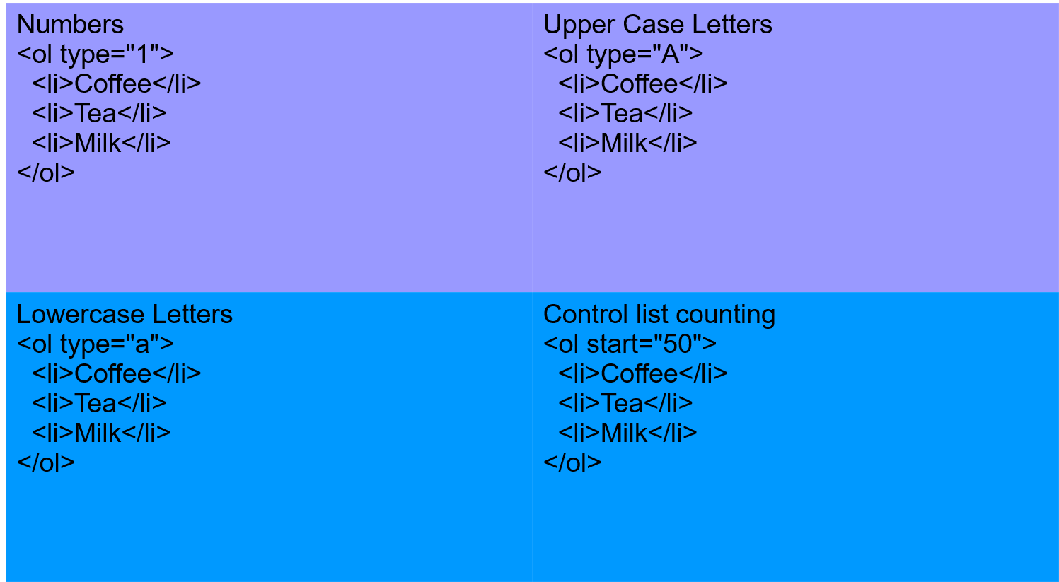

Slide 8
Unordered List <ul>
An unordered list. This will list items using plain bullets.
Each item in the list is marked with a bullet.
Use type attribute for <ul> tag to specify the type of bullet you like. By default it is a disc.
<ul>
<li>Amber Fort and Palace</li>
<li>Nahargarh Fort</li>
<li>Hawa Mahal</li>
</ul>
<ul type="square">
<ul type="circle">
<ul type="disc">

Slide 9
HTML audio element
Audios can be added to webpages using the <audio> tag.
Previously audios could be only played on webpages using web plugins like Flash.
<audio controls>
<source src="horse.ogg" type="audio/ogg">
<source src="horse.mp3" type="audio/mpeg">
Your browser does not support the audio element.
</audio>
The controls attribute adds video controls, like play, pause, and volume.

Slide 10
HTML Video Element
The <video> tag is used to display a video file on a web page.
<video width="320" height="240" controls>
<source src="movie.mp4" type="video/mp4">
<source src="movie.ogg" type="video/ogg">
Your browser does not support the video tag.
</video>

Slide 11
Creating Table
Tables are used in web pages to enhance the readability by presenting information in a structured way.
By using tables, inforation can be arranged logically in rows and coloums.
Table divides into 3 parts:
i) Body
ii) Header
iii) Footer

Slide 12
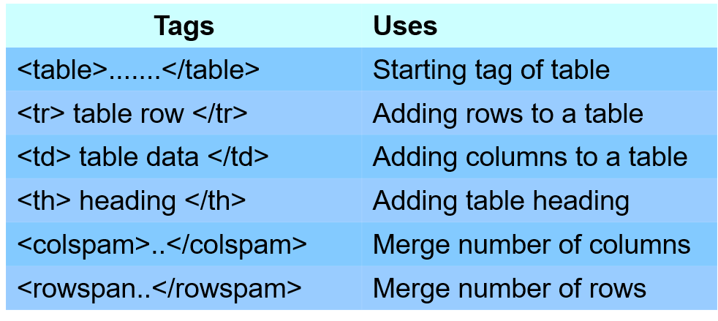
Table Body
Table body contains data arranged in rows.

Slide 13

<table border =”1”><tr> <th>Firstname</th> <th>Lastname</th> <th>Age</th> </tr><tr> <td>Jill</td> <td>Smith</td> <td>50</td> </tr><tr> <td>Eve</td> <td>Jackson</td> <td>94</td> </tr></table>

Slide 14
Thanks!
Do you have any questions?
likhithkanigolla@gmail.com +91 9573618704 likhithlpu.web.app

